Slide 1
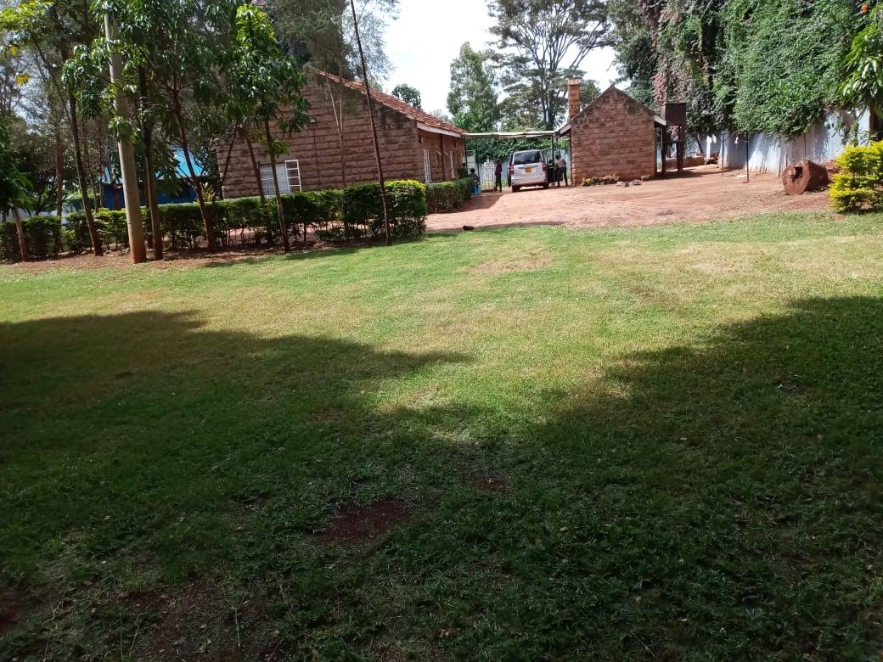
Kwaheri 2020 – Goodbye 2020
Yes, 2020 was a year of saying goodbye to life as we had known it. But it was also a year of new beginnings. Our girls got to experience wonderful things for the very first time, things we may often take for granted like attending a wedding, riding a bike, baking a cake, or learning to use a computer. And for
7 girls, being the first person in their entire family to attend high school, completely changing the story for generations to come. Awesome.
Karibu 2021 - Welcome 2021
Did you know? Every New Year’s Day is a special milestone for One Lamb. We started on January 1st 2012, we are now 9 years old.
With each passing year, the most frequently asked question is how many girls we have. But beyond the numbers, for each girl in our care it’s not just how many years they have been with us that counts, it’s how many years of unspeakable suffering they have been spared from in their future because they have been with us.
This is God’s amazing grace, truly worth celebrating.
Asante
Thank You
We thank God for His endless goodness and for the special way we received it through you our friends in 2020.
During the darkest days of Covid, the girls felt remarkably safe in our Hearthome – we are extremely grateful for our landlords who have always been most gracious to us. We are grateful for friends who went out of their way to send generous financial gifts to make sure we were ok, along with numerous items from gumboots for gardening, to clothes, supplies and lovely exotic meals. Thank you.
On top of all this, the most precious gift the girls received during the
extended time off school was digging into God’s Word, loving it, and having tremendous heart transformations. We walked through the Gospels and the girls learned forgiveness, humility, hope, self worth – all from how Jesus welcomed the outcasts, the ones society saw as the “least of these.” The girls could relate, Jesus welcomes them. For this they are eternally grateful.
As the girls now prepare to go back to school, we thank you for your continued precious support, prayers, encouragement that helps to keep us going and has an impact for years and years to come. Asante.

